Slide 1

Narasaraopeta Engineering College
Department of CSE(DataScience)
Project tittle
On
Glaucoma Identification Using CNN Ensemble for Optic Disc and Cup
Segmentation
Submitted By
D. Mounika (22471A4417)
G.Shanmukha (22471A4458)
K.Madhav (22471A4428)
Under the Gudience
Mr.J.SyamBabu

Slide 2
Abstract
Glaucoma is a leading cause of irreversible blindness globally.
Early detection is crucial for vision preservation and treatment.
Optic disc and cup segmentation is vital for accurate CDR calculation.
CNN ensembles provide robust segmentation of retinal structures.
Model trained on retinal fundus datasets to detect glaucoma markers.
Supports scalable, automated glaucoma screening in healthcare systems.

Slide 3
Introduction
Glaucoma progressively damages the optic nerve, leading to blindness.
Screening involves evaluating the optic disc and cup in retinal images.
Manual screening is time-consuming and subjective.
Automated systems enhance early detection and clinical workflows.
CNNs excel in extracting features from complex medical images.
Ensemble methods improve accuracy and robustness in segmentation.

Slide 4
Problem Statement
Glaucoma is one of the major causes of irreversible blindness, resulting from damage to the optic nerve.
Early detection of glaucoma is essential to prevent permanent vision loss and preserve eyesight.
Traditional glaucoma diagnosis relies on manual observation of retinal fundus images by ophthalmologists.
Manual estimation of the Cup-to-Disc Ratio (CDR) is a key diagnostic step but is time-consuming and subject to human error.
Differences in image quality, lighting, and anatomical variations make manual segmentation inaccurate and inconsistent.
There is a need for an automated system that can accurately segment the optic disc and optic cup from retinal fundus images.

Slide 5
Objective
Glaucoma is a major cause of irreversible blindness, and early detection is crucial to prevent vision loss. Manual diagnosis using retinal fundus images is time-consuming and prone to human error. This project uses Convolutional Neural Networks (CNNs) to automatically segment the optic disc and optic cup for accurate Cup-to-Disc Ratio (CDR) calculation. An ensemble of CNN models is employed to improve segmentation accuracy and reliability. The system provides a fast, consistent, and automated solution for early glaucoma detection, assisting ophthalmologists in clinical diagnosis.
To accurately detect and classify glaucoma using retinal fundus images.
To segment the optic disc and optic cup regions for precise analysis.

Slide 6
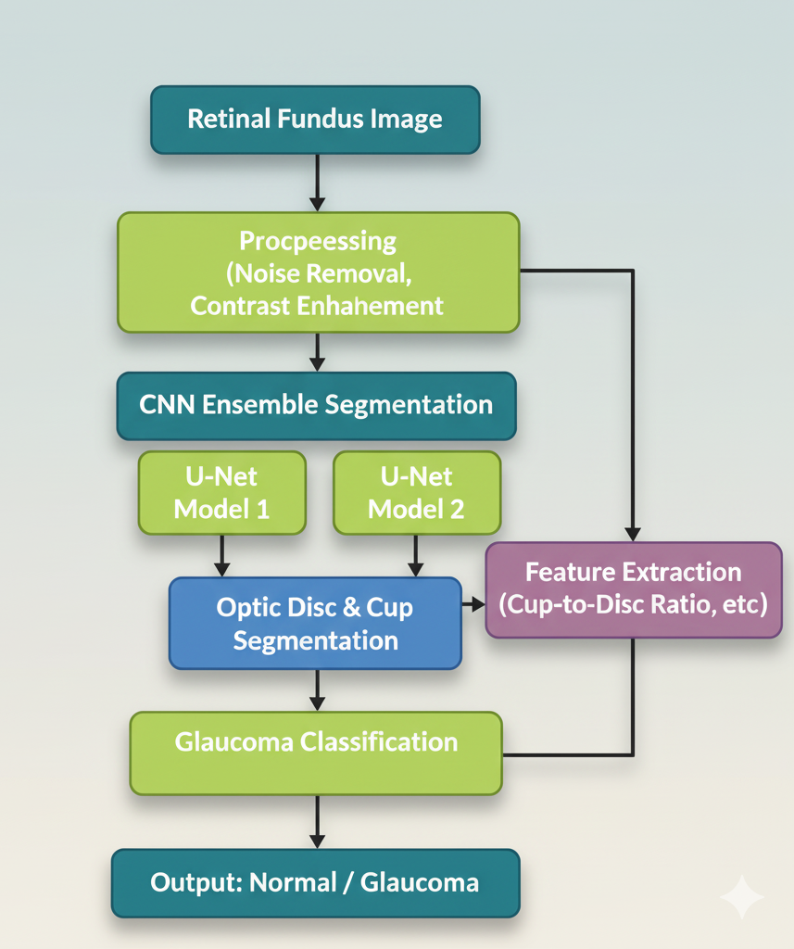
Proposed system
Input Acquisition: Collect retinal fundus images using fundus cameras or OCT devices.
CNN Ensemble Segmentation: Use multiple CNN models (e.g., U-Net, ResNet-based U-Net) to segment the optic disc (OD) and optic cup (OC).
Feature Extraction: Calculate Cup-to-Disc Ratio (CDR) and other relevant features from segmented regions.
Glaucoma Classification: Ensemble outputs are combined to classify images as normal or glaucomatous.
Performance Evaluation: Use metrics like accuracy, dice coefficient, sensitivity, specificity, and CDR error.
Advantages: Higher accuracy, robust to image variations, reduces manual intervention, and supports early glaucoma detection.

Slide 7
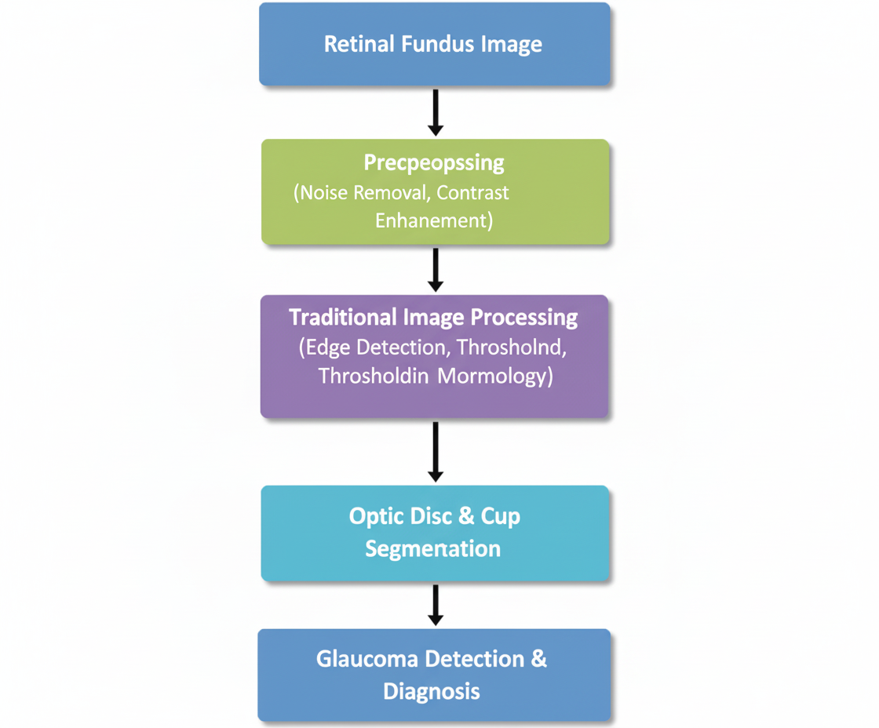
Existing system
Manual Diagnosis – Traditionally, glaucoma is detected by ophthalmologists through visual inspection of retinal images and measuring the cup-to-disc ratio (CDR).
Fundus Imaging Tools – Optical Coherence Tomography (OCT) and fundus cameras are used to capture retinal images for analysis.
Single CNN Models – Some systems use a single convolutional neural network for segmentation and classification, which may fail in complex cases or poor-quality images.
Limitations – Existing systems are less robust, prone to errors in noisy images, and often require significant preprocessing and expert intervention.

Slide 8
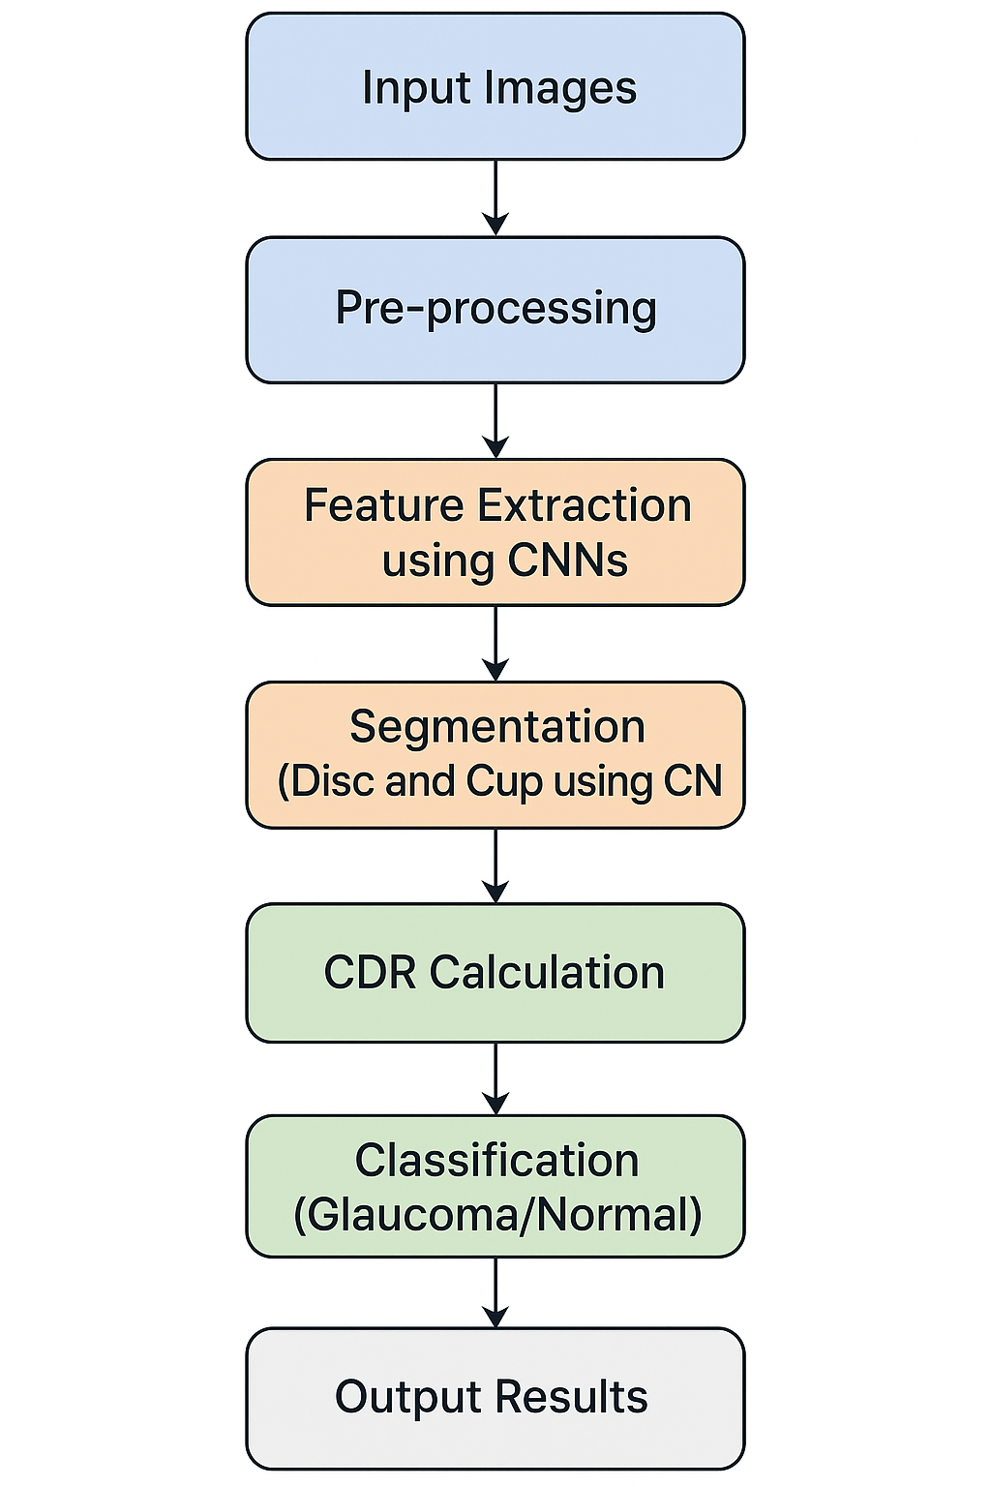
System Architecture
Input Module: Uploads retinal fundus images for analysis.
Pre-processing: Enhances image quality and removes noise.
Feature Extraction: CNNs extract key features from optic disc and cup.
Segmentation: CNN ensemble segments optic disc and cup regions.
CDR Calculation: Computes Cup-to-Disc Ratio to assess glaucoma risk.
Classification: Identifies images as Glaucoma or Normal.
Output Module: Displays results with segmented images and reports.

Slide 9
Result analysis : Ensemble CNN accurately classifies Glaucoma vs Non-Glaucoma. Segmentation highlights optic disc & cup, calculates CDR for verification. Visual results help doctors validate predictions quickly.
Class | Accuracy (%) | Sensitivity (%) | Specificity (%)
Glaucoma | 95 | 96 | 94
Non-Glaucoma | 95 | 94 | 96

Slide 10
Advantages
Objectivity and Consistency: By using AI-based segmentation, the system minimizes human subjectivity and ensures consistent results. Traditional manual CDR (Cup-to-Disc Ratio) calculations often vary between different ophthalmologists.
Time Efficiency: The system is designed for high-speed processing, handling images in less than three seconds to meet clinical workflow requirements. It operates in supervised (18 ms/image) and unsupervised (25 s/image) modes.
High Accuracy: The hybrid CNN-RNN model achieves high precision, with 92.4% accuracy for optic disc segmentation and 91.7% for the optic cup.

Slide 11
Disadvantages
Boundary Ambiguity: Segmenting the optic cup remains challenging because cup boundaries are inherently ambiguous and vary significantly depending on pathology and imaging conditions.
Single-Model Brittleness: Individual CNN models can fail under unusual imaging conditions, such as very low contrast or strong vessel overlays.
Sensitivity to Image Quality: Classical methods often fail when images are affected by blur, noise, or illumination changes.
Data Requirements: The system relies on large, expert-annotated datasets (like ORIGA) for effective training and optimization.

Slide 12
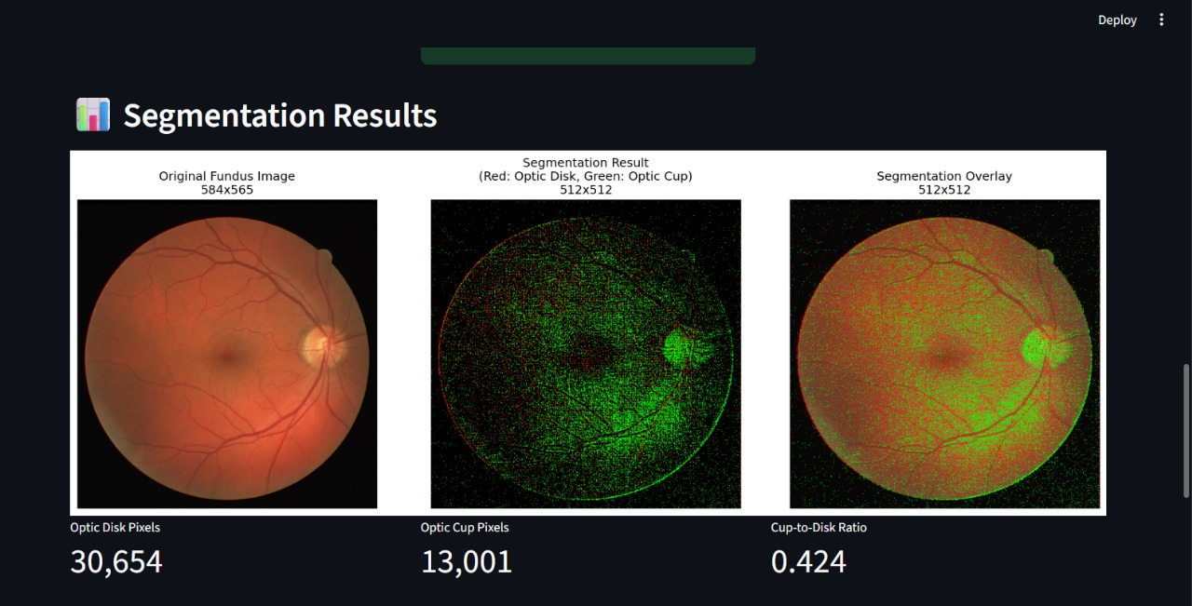
Output Screens

Slide 13
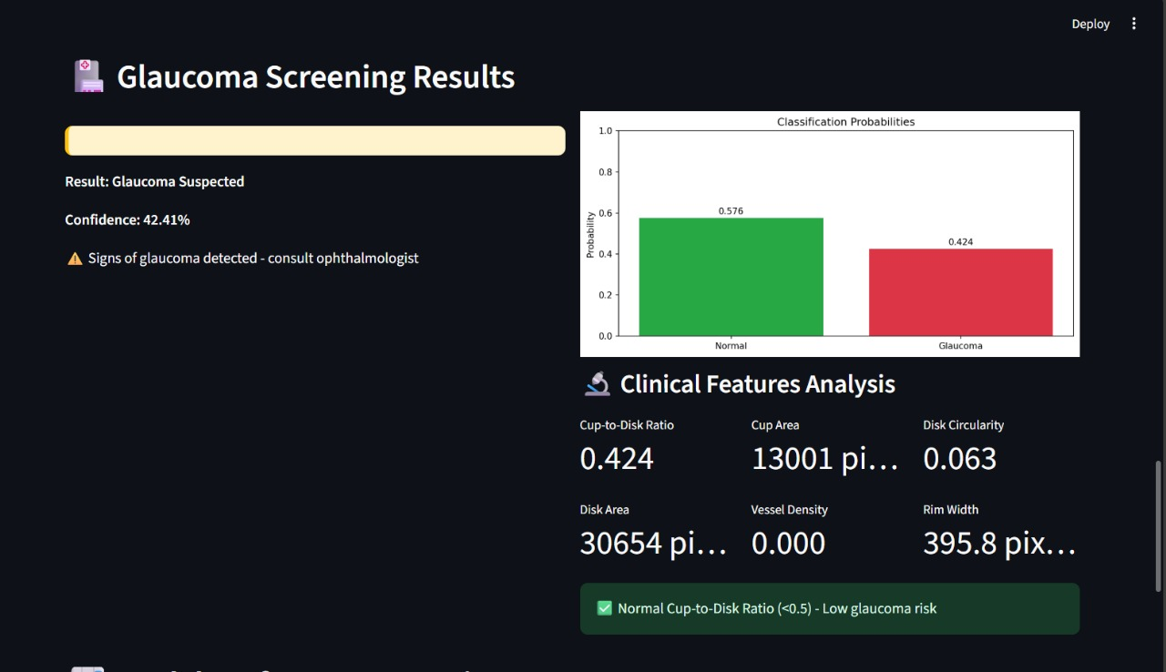

Slide 14
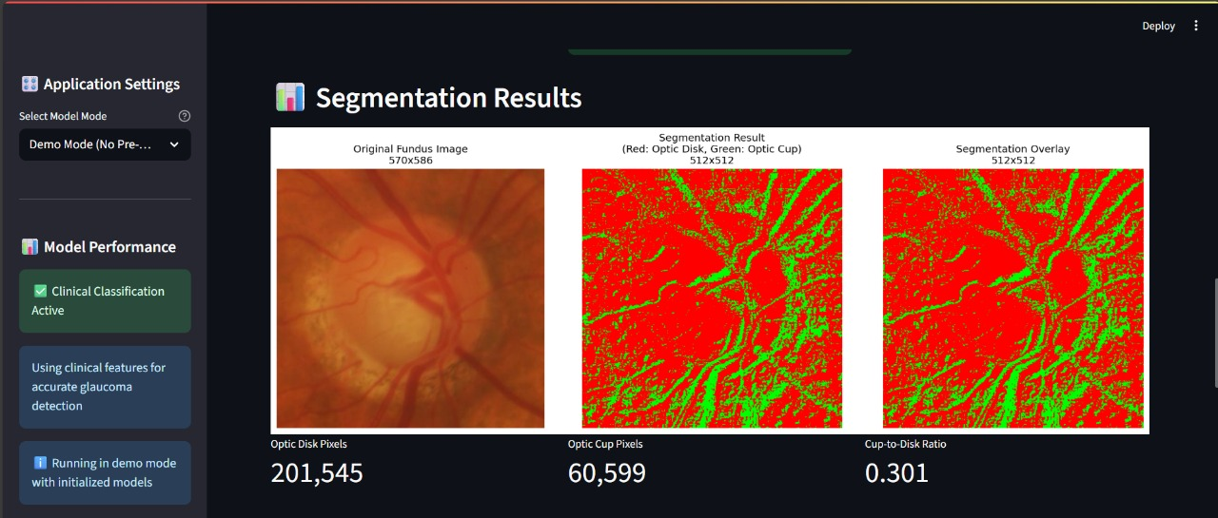

Slide 15
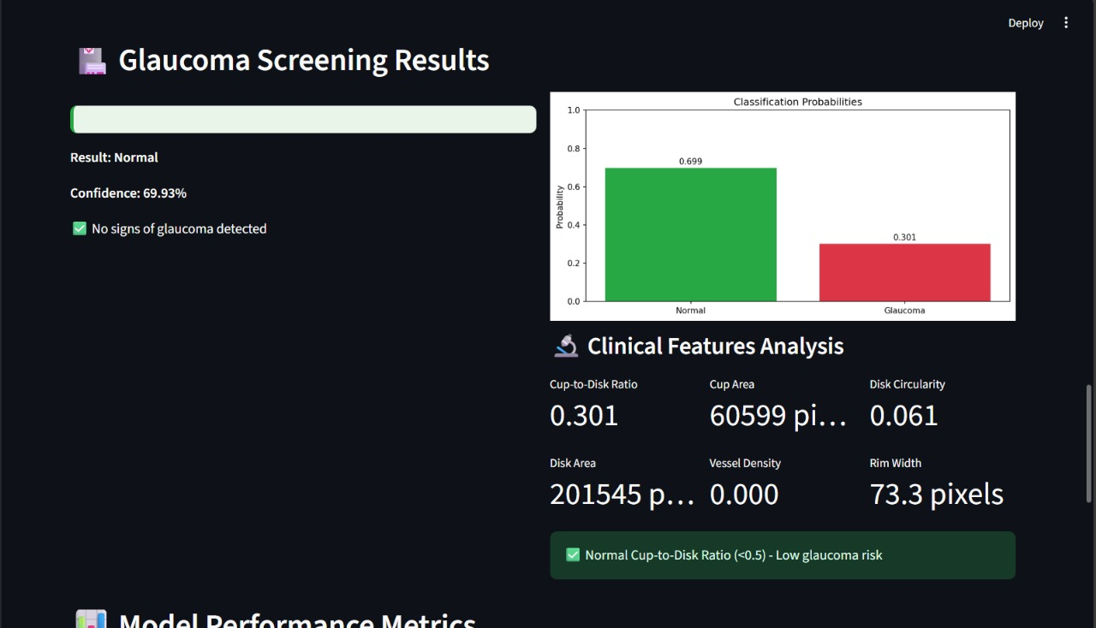

Slide 16
Conclusion
The proposed Optic Disc and Cup Segmentation System provides an automated, efficient, and reliable method for early glaucoma detection using retinal fundus images. By integrating advanced deep learning architectures such as U-Net, the system achieves precise segmentation of the optic disc and optic cup, enabling accurate computation of the Cup-to-Disc Ratio (CDR) — the key indicator for diagnosing glaucoma.
Compared to traditional manual or rule-based methods, the system minimizes human intervention, reduces diagnostic errors, and enhances consistency. The preprocessing techniques applied ensure high-quality image input, while the segmentation and classification stages deliver clinically relevant results with improved accuracy and robustness.

Slide 17
Future Scope
Dataset Expansion: Use larger and more diverse retinal datasets to improve model accuracy and generalization.
Early Detection: Enhance sensitivity to identify early-stage glaucoma and subtle optic nerve changes.
Multimodal Integration: Combine fundus images, OCT scans, and IOP data for more reliable diagnosis.
Mobile & Cloud Deployment: Develop a lightweight version for real-time glaucoma screening on mobile or edge devices.
Explainable AI (XAI): Add visualization tools to show how the model makes decisions — improving clinical trust.
Clinical Integration: Integrate the system into hospital diagnostic workflows and teleophthalmology platforms.

Slide 18


